Slide 1
MID-DAY MEAL SCHEME IN GUJARAT
2020-21
Prepared by:
DEPARTMENT OF EDUCATION (PRIMARY AND SECONDARY)

Slide 2
Agenda
1. Mid Day Meal Scheme in Gujarat
2. AWP-PAB for 2020-21
3. Initiatives by the State Government
4. New proposals
5. Good practices by the State Government

Slide 3
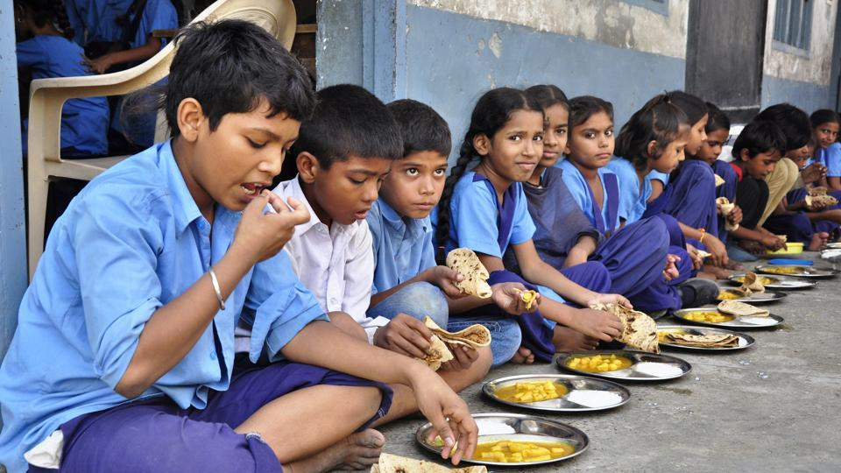
MID DAY MEAL SCHEME IN GUJARAT
2019-20

Slide 4
Overview of Mid-Day Meal 2019-20
96,329 Cook cum Helpers
3,346 modern Centralised Kitchens managed by four NGOs
Benefit to 6.53 Lakh Children
77.28% Beneficiary Coverage
243 MDM provided against approved 248 MDM
2019-20 Budget: Rs. 1034.40 Crores
Central Share: Rs. 448.85 Crores
State Provision: Rs.585.55 Crores

Slide 5
Year on Year Scheme Coverage
Students (in lakhs)

Slide 6
Details of Materials and Nutrients
180 gms Meal
525 Calories against the prescribed 480 Calories
265 gms Meal
743 Calories against the prescribed 720 Calories

Slide 7
Grant Received vs Expenditure
85% Grant Received against Budget in 2019-20
91% Expenditure against Grant Received in 2019-20
Rs. in Crore

Slide 8
Mid-Day Meal Evaluation Study
Students Feedback
About Quality of Food
Parents Feedback
About Quantity of Food
*An evaluation study report by Directorate of Evaluation, Government of Gujarat submitted in March 2020
*Study included 140 schools across 14 districts and 3 corporation covering 37,004 students

Slide 9
Recommendations

Slide 10
Mid Day Meal Scheme – Cooking Cost Details
Sr No | Cooking Cost Head | Cost per Child per Day (In Rs)
 |  | I-V | VI-VIII
01 | Vegetables & Spices | 1.68 | 2.54
02 | Fuel Cost | 0.81 | 1.20
03 | Miscellaneous | 0.10 | 0.14
04 | Basket of Pulses | 1.41 | 2.11
05 | Edible oil | 0.48 | 0.72
 | Cooking Cost (as per GoI Scheme) | 4.48 | 6.71
06 | Edible oil (State Share) | 0.48 | 0.25
 | Total Cooking Cost (with State share) | 4.96 | 6.96
Note
Organiser gets Rs. 2.59 and 3.88 per child per day as advance for Primary and Upper Primary classes respectively for vegetables and spices, fuel and miscellaneous (nos 1-3) items
State government organises for basket of pulses and edible oil through Civil Supply Corporation
Rice and wheat are provided by GoI through FCI

Slide 11
Recommendations
Considering prevailing rates of food items and other raw materials, cooking cost should be increased
Monthly honorarium paid to Mid-Day Meal staff should be increased
Supply of good quality of raw materials with sufficient quantity should be ensured
To address the shortage of ration, there should be advance arrangement particularly in the beginning of academic session for raw food stock
School heads should be instructed to plan the ration at their own level or through other schools who have excess stock
Once a week seasonal fruits, green leafy vegetables and milk can also be given
Chana chat is given thrice a week, instead of repeating same item for three days other food items like Poha, Upma etc can be given

Slide 12
AWP-PAB 2020-21

Slide 13
2019-20: Component Wise Grant vs Expenditure
Component | PAB Approval for 2019-20 |  |  | Received Grant for 2019-20 |  |  | Expenditure for 2019-20 |  |  | Difference (Unutilised grant)
 | Central | State | Total | Central | State | Total | Central | State | Total | Central | State | Total
Cost of Food Grain | 3,333.7 | - | 3,333.7 | 3,230.6 |  | 3,230.6 | 2,891.6 |  | 2,891.6 | 339.0 | 0.0 | 339.0
Cooking Cost | 34,781.5 | 23,158.4 | 57,939.9 | 27,676.0 | 18,450.7 | 46,126.7 | 25,376.7 | 16,710.7 | 42,087.4 | 2,299.3 | 1,740.0 | 4,039.3
Honorarium to Cook Cum Helper | 5,895.4 | 3,930.2 | 9,825.6 | 5,369.8 | 3,579.9 | 8,949.7 | 5,563.1 | 4,034.4 | 9,597.5 | -193.3 | -454.5 | -647.8
Transportation Assistance | 1,833.5 | - | 1,833.5 | 1,745.7 |  | 1,745.7 | 877.2 |  | 877.2 | 868.5 | 0.0 | 868.5
Management, Monitoring and Evaluation (MME) | 1,237.8 | - | 1,237.8 | 1,264.6 |  | 1,264.6 | 903.4 |  | 903.4 | 361.2 |  | 361.2
Total | 47,081.8 | 27,088.7 | 74,170.5 | 39,286.7 | 22,030.6 | 61,317.3 | 35,612.0 | 20,745.1 | 56,357.1 | 3,674.7 | 1,285.5 | 4,960.2
(Rs. in Lakhs)

Slide 14
2020-21: Proposed Budget
Component | PAB Approval for 2019-20 |  |  | Proposed Budget for 2020-21 |  |  | Percentage Change from 2019-20
 | Central | State | Total | Central | State | Total | Central | State | Total
Cost of Food grain | 3,333.7 |  | 3,333.7 | 2,923.6 |  | 2,923.6 | -12.3% |  | -12.3%
Cooking Cost | 34,781.5 | 23,158.4 | 57,939.9 | 34,848.9 | 23,253.4 | 58,102.2 | 0.2% | 0.4% | 0.3%
Honorarium to Cook Cum Helper | 5,895.4 | 3,930.2 | 9,825.6 | 5,779.7 | 3,853.2 | 9,632.9 | -2.0% | -2.0% | -2.0%
Transportation Assistance | 1,833.5 |  | 1,833.5 | 1,754.1 |  | 1,754.1 | -4.3% |  | -4.3%
Management, Monitoring and Evaluation (MME) | 1,237.8 |  | 1,237.8 | 1,223.3 |  | 1,223.3 | -1.2% |  | -1.2%
Total | 47,081.8 | 27,088.7 | 74,170.5 | 46,529.6 | 27,106.5 | 73,636.1 | -1.2% | 0.1% | -0.7%
(Rs. in Lakhs)

Slide 15
Initiatives by
State Government

Slide 16
Distribution of Food Grains and Cooking Cost while schools are closed due to COVID-19
Food Security Allowance was distributed for 36 days between March 16 to May 03, until summer vacation began
Standard | Number of Children | Number of days | Food grain (in MTs) | Cooking Cost (Rs in Lakh)
Primary | 32,67,671 | 36 | 11,763.62 | 5,834.75
Upper Primary | 19,04,617 | 36 | 10,284.93 | 4,772.21
Total | 51,72,288 | 36 | 22,048.55 | 10,606.96

Slide 17
Tracking Student Attendance Data and MDM MIS Data on a Daily Basis
School Support team out of Command and Control Centre, Gandhinagar monitors daily attendance and meal served data daily and highlight mis matches, if any for the corrective actions

Slide 18
New App to Manage Stock and Supplies
An integrated app for managing stock, demand, distribution and monitoring till school level has been developed band being tested on ground
Indents for stock requirements are auto- generated based on real-time data

Slide 19
Kitchen Garden
The vegetables & fruits grown in these Kitchen Gardens are used in the preparation of MDM
In 2019-20, total 10,212 Kitchen Garden are deeveloped In schools.
9,844 Kitchen Gardens are proposed to be developed in 2020-21
Cost of the initiative is estimated to be Rs. 4.92 Crore @ Rs.5,000 per unit of Kitchen Garden
Proposed cost breakup of the total estimate of Rs. 492.20 Lacs is as follows:
60% Central share : 295.32 Lakhs
40% State share : 196.88 Lakhs

Slide 20
Improving Nutrition through Fortification
Fortified rice addresses Folic acid, Iron and Vitamin B12 requirements among the children
Fortified rice will be added to the MDM where prevalence of malnourishment is high and for the vulnerable groups like children of salt-pan workers in Desert area of Kutch region.
Pilot project has been started in Narmada district by Food Civil Supply and Consumer Affairs Department for implementation of rice fortification project

Slide 21
Expansion of Centralised Kitchens
It is proposed to start new centralised kitchens in the academic year 2020-21
92 new centers by AkshayPatra in Jamnagar Rural and Lalpur Talukas covering 15,780 beneficiaries
58 new centers by AkshayaPatra in Jamnagar Municipal Corporation covering 17,123 beneficiaries

Slide 22
Consumption of Iron Folic Acid Tablets
Iron Folic Acid Tablets are made available to Adolescent Girls in Schools by State Health Department, however there is no effective monitoring system to ensure if they are consumed immediately after the meal by adolescent girl in Schools regularly.
It is proposed to have one teacher in each school as the Nodal Person to ensure that Iron Folic Acid Tablets are consumed by adolescent girls in schools as per schedule.

Slide 23
Chiki Distribution to Children of Saltpan Workers
30 Schools on Wheels for Children of Saltpan Workers who migrate temporarily in Kutch desert area. Due to temperature difference between day and night and cold in the desert area, these children need more energy and nutrition
Distribution of 50 gram peanut Chiki/Dalia Chiki/Tal Chiki to 511 Children of Saltpan Workers studying in these schools is being done
Distribution would be carried out for 120 days in a year
Cost of the initiative is estimated as INR 5,51,880 in the year 2020-21 considering Chiki price @ Rs.180 Per Kg

Slide 24
Provision for Food Grains and Cooking Cost during Summer Vacation
Food Security Allowance (Food grains + Cooking Cost) for all entitled students studying in standard 1 to 8 during 34 days long summer vacation (from May 04 to June 07) vide resolution no.-MBY/2020/GOI-9/R dated May 15, 2020
Standard | Number of Children | Number of days | Food Grains (in MTs) | Cooking Cost (in Rs.Lakh) | Transportation Assistance (in Rs.Lakh)
Primary | 32,67,671 | 34 | 11,110.08 | 5,521.71 | 166.65
Upper Primary | 19,04,617 | 34 | 9,713.54 | 4,824.40 | 145.70
Total | 51,72,288 | 34 | 20,823.62 | 10,346.11 | 312.35

Slide 25
Good Practices by the
State Government

Slide 26
Two Time Meals
Gujarat provides 525 and 743 calories against required 480 and 720 calories (as per GoI guidelines) in primary and upper primary schools respectively.
The weight gets double to about 400 grams when it is cooked.
400 grams of food is too much to have in a single meal for children studying in Primary and Upper Primary classes.
In view of this, children are provided with two meals i.e. breakfast and lunch in the school under MDMS
DAY | BREAK FAST | LUNCH
Monday | Sukhdi | Vegetable khichdi
Tuesday | Chana Chat | Thepala & Bhaji
Wednesday | Mix Dal/ Usal | Vegetable Pulav
Thursday | Chana Chat | Dal Dhokli
Friday | Muthiya | Dal-Bhat
Saturday | Chana Chat | Vegetable Pulav

Slide 27
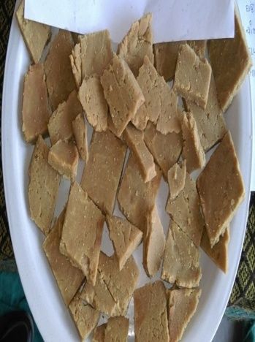
Sukhadi Project
Sukhadi is served with an aim to enhance calorie and protein intake by students
Sukhadi (a local nutritious dish made of wheat, jaggery and oil) is served once a week and is approved by the CFTRI (Central Food Technological Research Institute) and nutrition experts
INR 13.07 Crore has been spent on this project in the FY 2019-20

Slide 28
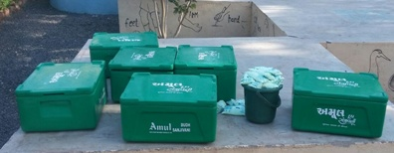
Doodh Sanjivani Yojana – milk in MDMS
200 ml. of flavored milk is served 5 days in a week to primary school children under the scheme
Currently, 26 developing Talukas acress 12 Districts are covered under this scheme
3.15 Lakh students are getting benefitted under the scheme
Expenditure in 2019-20 – INR 44.58Crore
In addition to this, Tribal Development Department of the State Government is providing 200 ml. flavored milk in 51 Talukas across 14 tribal districts

Slide 29
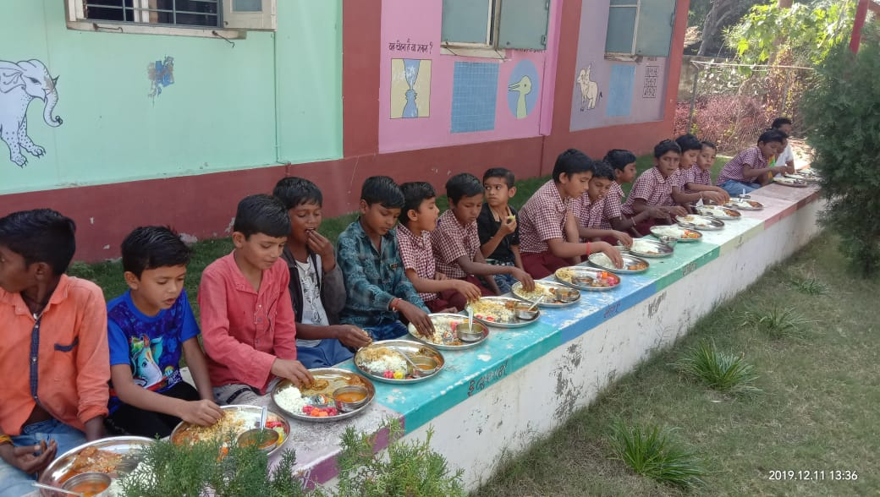
Tithi Bhojan – Promoting Community Participation in MDMS
Year | Beneficiaries
2017-18 | 65.56 Lakhs
2018-19 | 52.22 Lakhs
2019-20 | 85.12 Lakhs
The villagers sponsor the food with sweets, namkeen, farsan, fruits for children on various occasions for MDM centers
It is customary in Gujarat to host public dinner on festival days or social occasions like
Marriage anniversary
Birth Anniversary
Death anniversary
Any special occasion like any educational or social achievement like ranking first in school, promotion etc

Slide 30
Anna Sangam Yojana Free Food Grains to Tribal Girl Students
Benefit of the scheme is given to the tribal girls for up to two tribal girls in the family
60 kg (per term 30 kg) food gains (15kg wheat, 15kg Rice) is given to the beneficiary annually.
Criteria: must have more than 70 % annual attendance
Expenditure in 2019-20: INR 68.00 Crore

Slide 31
Thank You!
Department of Education
(Primary and Secondary), Gujarat

